Slide 1
Programming with C
Lecturer : Odile Nzambazamariya Lecture 2: Variables and Data Types
Adventist University of Central Africa

Slide 2
Outlines
Character set
Identifiers
Keywords
Variables
Declaring variables
Data types
Displaying variables
Reading variables
Qualifiers
Constants

Slide 3
Character set
In C, a character set is a group of recognized characters that are available for usage in the source code. These characters are the building blocks that make variables, functions, operators, and constants.
In short, a collection of characters, numbers, and symbols that the C compiler recognizes is known as a character set.

Slide 4
Character set
The C language has a rich character set. It can be described under 3 main headings:
Alphabets: These are alphabets of English language and can be in upper or lower case. (E.g. A,B,C…..Z || a,b,c,…z)
Digits: 0,1,2,…,9.
Special Symbols: The C language also allows the use of special symbols such as →(),[],{},~!@#%^&$*_-+=`\|;:’”,./?

Slide 5
Character set
Types of Character Sets in C Language
Character set in C language are split into two main categories:
Source Character Set (SCS)
Execution Character Set (ECS)

Slide 6
Character set
Source Character Set (SCS)
The Source Character Set defines all characters allowed when writing C programs.
It includes:
Alphabets: Uppercase (A–Z) and lowercase (a–z)
Digits: 0 to 9
Special Characters: Symbols such as +, -, *, /, =, { }, ( ), ; , etc.
Whitespace Characters: Space, tab (\\t), and newline (\\n) used for code formatting
Escape Sequences: Special symbols like \\n, \\t, \\\\ used inside strings
Extended Characters: Non-ASCII characters used for international symbols (e.g., é, ç, ¥)

Slide 7
Character set
2. Execution Character Set (ECS)
The Execution Character Set defines the characters processed by the system
when a C program runs.
It includes:
All Source Character Set characters: Letters, digits, symbols, and whitespace
used in the code.
Control Characters: Non-printable characters such as newline (\\n), tab (\\t), and
carriage return (\\r) used to control output formatting during execution.

Slide 8
Identifiers
Identifiers are the names we choose for a function, variable, list, array, or other user-defined item. They are used to uniquely identify these elements in the code. Once we assign a name to any entity, we cannot use the same name for any other entity. Some rules must be followed in the C program while naming an entity.

Slide 9
Identifiers
Rules for Naming Identifiers
After assigning a name to a variable, function, array, or any other entity, you cannot assign the same name to other entities in the same scope.
In the C program, every identifier must start with an uppercase or lowercase letter. You can also use an underscore (‘_’) at the beginning.
Identifiers in the C program are treated differently. “PhysicsWallah” and “physicsWallah” are two different identifiers.
Also, you cannot use keywords as an identifier in the C program.
Special characters like @, $, %, etc., are not allowed while naming the identifiers.
You cannot use blank spaces or commas while naming an identifier.
The maximum length of an identifier can go up to 31 characters long.

Slide 10
Identifiers
Examples of Valid Identifiers:
Count
total_sum
MAX_VALUE
myVariable1

Slide 11
Identifiers
Examples of Invalid Identifiers:
1variable (starts with a digit)
total sum (contains a space)
int (reserved keyword)

Slide 12
Keywords
There are certain words reserved for doing specific task, these words are known as reserved word or keywords. These words are predefined and always written in lower case or small letter. These keywords can not be used as a variable name as it assigned with fixed meaning.

Slide 13
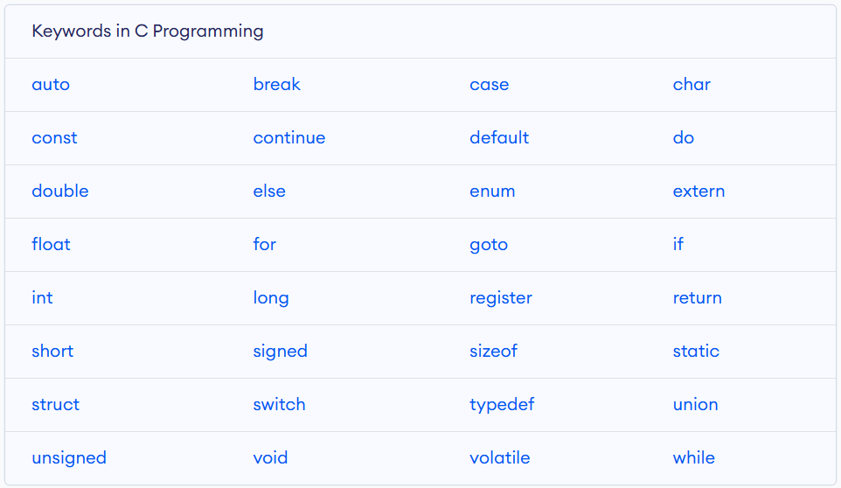
Keywords

Slide 14
Difference Between Keywords and Identifiers in C language
Keywords are the predefined words in a programming language. | Identifiers are the names given to variables, functions, lists, etc.
Keywords in C language cannot be used as identifiers. | Identifiers are user-defined variables that give a unique name to different entities in programming.
The keywords always start with a lowercase letter. | Identifiers can start with either lowercase or uppercase letters.
It only contains alphabetical characters. | It contains only numerals, letters and underscores. No special symbols are allowed.
It specifies the data type of an entity. | It gives the name of an entity.
You can use keywords as many times as you want. | You cannot use the same identifiers name in the same scope.
Example: int, float, double, if, else, default, etc. | Example: int num, where num is an identifier.

Slide 15
Variables
In programming, we often need a named storage location to store the data or values. Using variables, we can store the data in our program and access it afterward.
Variables are containers for storing data values, like numbers and characters.

Slide 16
Variables
In C, there are different types of variables (defined with different keywords), for example:
int: stores integers (whole numbers), without decimals, such as 123 or -123
float: stores floating point numbers, with decimals, such as 19.99 or -19.99
char: stores single characters, such as 'a' or 'B'. Characters are surrounded by single quotes

Slide 17
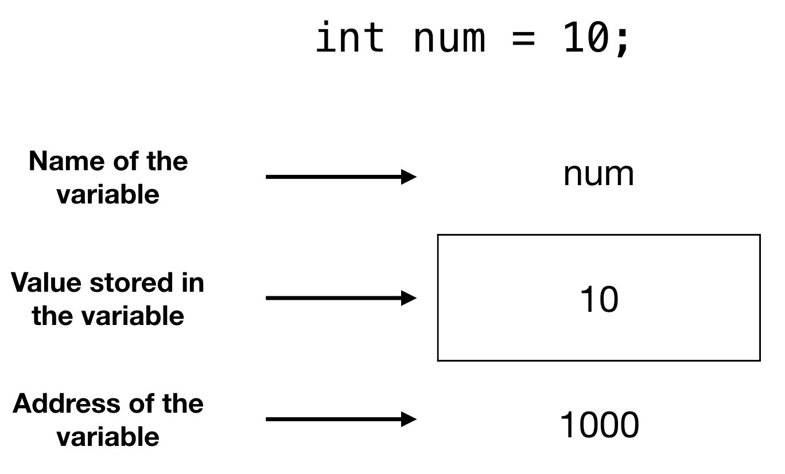
Variables

Slide 18
Declaring variables
In programming, the declaration of variables involves specifying the type and name of a variable before it is used in the program. The syntax can vary slightly between programming languages, but the fundamental concept remains consistent.
To create a variable, specify the type and assign it a value.

Slide 19
Declaring variables
Rules for Declaring Variables in C
A variable name can only contain letters, digits, and underscores. It must begin with a letter or underscore.
C is case-sensitive, so variables 'abc' and 'ABC' are considered different.
A variable name cannot be a reserved word in C, such as 'int' or 'float'.
A variable must be declared before it is used in the program.

Slide 20
Declaring variables
Syntax
type variableName = value;
Where type is one of C types (such as int), and variableName is the name of the variable (such as x or myName). The equal sign is used to assign a value to the variable.

Slide 21
Declaring variables
Here are some examples of declaring variables in C:
int age;
float average;
char grade;
char name[30];
In these examples, 'age' is an integer variable, 'average' is a floating-point variable, 'grade' is a character variable, and 'name' is a string variable (an array of characters).

Slide 22
Declaring variables
Examples of Valid Variables in C
int age;
float average_grade;
char _grade;
char first_name[30];

Slide 23
Declaring variables
Examples of Invalid Variables in C
int 123abc; // variable name cannot start with a digit
float float; // float is a reserved word
char #grade; // variable name cannot contain special characters
char first name[30]; // variable name cannot contain a space

Slide 24
Declaring variables
You can also declare a variable without assigning the value, and assign the value later:
Example:
// Declare a variable
int myNum;
// Assign a value to the variable
myNum = 15;

Slide 25
Declaring variables
#include <stdio.h>
int main()
{
// Syntax: datatype variable_name;
int age;
double price;
char grade;
return 0;
}

Slide 26
Declaring variables
Initialization of Variable
Initialization of variables In Programming involves assigning an initial value to a declared variable. The syntax for variable initialization varies across programming languages.

Slide 27
Declaring variables
Initialization of Variable
Example
#include <stdio.h>
int main()
{
// Declaration and Initialization
int age = 25;
double price = 10.99;
char grade = 'A';
return 0;
}

Slide 28
Data types
Each variable in C has an associated data type. It specifies the type of data that the variable can store like integer, character, floating, double, etc.
Each data type requires different amounts of memory and has some specific operations which can be performed over it.
The data type is a collection of data with values having fixed values, meaning as well as its characteristics.

Slide 29
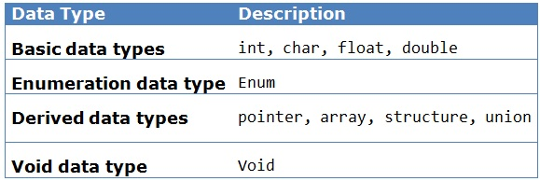
Data types

Slide 30
Data types
C has several built-in data types, which can be classified into the following categories:
Basic types: These include the most fundamental data types in C, such as char, int, float, and double. These data types are used to store characters, integers, and floating-point numbers, respectively.
Derived types: These are data types that are derived from basic types, such as arrays, pointers, and structures. Derived data types allow you to define more complex data structures by combining simpler data types.

Slide 31
Data types
Enumerated types: These are data types that consist of a set of named integer constants, known as an enumeration. Enumerated types are used to define a new data type that consists of a set of named integer constants.
Void type: This is a special data type that has no value and is used to specify the type of a function that does not return a value.

Slide 32
Data types
Integer Types
An integer is a data type in the C programming language that represents a whole number (without a fractional part) that can be either positive or negative. Integers can be classified into two categories:
Signed integers: These can represent both positive and negative numbers, and they include the types short, int, and long. The size of the integer (i.e., the number of bits used to represent it) determines its range of values.
Unsigned integers: These can only represent positive numbers, and they include the types unsigned short, unsigned int, and unsigned long. Like signed integers, the size of the integer determines its range of values.

Slide 33
Data types
The following table provides the details of standard integer types with their storage sizes and value ranges:
Type | Memory Size | Range
char | 1 byte | -128 to 127 or 0 to 255
unsigned char | 1 byte | 0 to 255
signed char | 1 byte | -128 to 127
int | 2 or 4 bytes | -32,768 to 32,767 or -2,147,483,648 to 2,147,483,647
unsigned int | 2 or 4 bytes | 0 to 65,535 or 0 to 4,294,967,295
short | 2 bytes | -32,768 to 32,767
unsigned short | 2 bytes | 0 to 65,535
long | 8 bytes or (4bytes for 32 bit OS) | -9223372036854775808 to 9223372036854775807
unsigned long | 8 bytes | 0 to 18446744073709551615

Slide 34
Data types
Float Data Types
In the C programming language, a float is a data type that represents a single-precision floating-point number. It is used to store decimal numbers (numbers with a fractional part) .
Type | Storage size | Value range | Precision
float | 4 byte | 1.2E-38 to 3.4E+38 | 6 decimal places
double | 8 byte | 2.3E-308 to 1.7E+308 | 15 decimal places
long double | 10 byte | 3.4E-4932 to 1.1E+4932 | 19 decimal places

Slide 35
Data types
The void Type
The void type specifies that no value is available. It is used in three kinds of situations:
No. | Types & Description
1 | Function returns as void There are various functions in C which do not return any value or you can say they return void. A function with no return value has the return type as void. For example, void exit (int status);
2 | Function arguments as void There are various functions in C which do not accept any parameter. A function with no parameter can accept a void. For example, int rand(void);
3 | Pointers to void A pointer of type void * represents the address of an object, but not its type. For example, a memory allocation function void *malloc( size_t size ); returns a pointer to void which can be casted to any data type.

Slide 36
Data types
Basic Format Specifiers
in C are special symbols used in functions like printf() and scanf() to tell the compiler what type of data is being printed or read. Think of them as placeholders for variables.
Format Specifier | Data Type
%d or %i | int
%f or %F | float
%lf | double
%c %s | Char string

Slide 37
Displaying variables
The C library printf() function is a fundamental tool for outputting formatted text to the standard output stream. It allows for versatile printing of variables, strings, and other data types.

Slide 38
Displaying variables
The syntax of the C Printf function is as follows:
printf("format string", argument1, argument2, ...);
The format string contains the text along with the format specifiers that should be replaced with the values provided in the argument list.
Example:int age = 25; printf("Your age is: %d", age);

Slide 39
Reading variables
The scanf() function is a commonly used input function in the C programming language. It allows you to read input from the user or from a file and store that input in variables of different data types.
Input is an essential part of most programs, and the scanf() function provides an easy way to read input in a variety of formats.

Slide 40
Reading variables
Scanf()format
The most common conversion specifiers are:
%d: reads an integer value
%f: reads a floating-point value
%c: reads a single character
%s: reads a string of characters
%lf: reads a double-precision floating-point value

Slide 41
Reading variables
Example: the following code reads an integer value and a floating-point value from the user, and stores them in the variables num and fnum, respectively:
#include <stdio.h>
int main() {
int num;
float fnum;
printf("Enter an integer and a floating-point number: ");
scanf("%d %f", &num, &fnum);
printf("You entered %d and %f\n", num, fnum);
return 0;
}

Slide 42
Reading variables
Example: the following code reads an integer value and a floating-point value from the user, and stores them in the variables num and fnum, respectively:
#include <stdio.h>
int main() {
int num;
float fnum;
printf("Enter an integer and a floating-point number: ");
scanf("%d %f", &num, &fnum);
printf("You entered %d and %f\n", num, fnum);
return 0;
}

Slide 43
Reading variables
In this example, the format string "%d %f" tells scanf() to read an integer value followed by a floating-point value, separated by a space.
The & operator is used to pass the address of the num and fnum variables to scanf(), so that the input values can be stored in those variables.

Slide 44
Qualifiers
type qualifiers: are keywords used to provide the compiler with additional information about how a variable's value should be treated and accessed.
two important qualifiers:
Const
volatile

Slide 45
Qualifiers
const Qualifier
const makes a variable read-only.
Once initialized, its value cannot be changed.
Example:
const float PI = 3.14;
const float PI = 3.15;//Not allowed

Slide 46
Qualifiers
volatile Qualifier
volatile tells the compiler that a variable’s value may change at any time.
The change may come from outside the program.
Example:
volatile int sensorValue;

Slide 47
Constants
Constant is a any value that cannot be changed during program execution. In C, any number, single character, or character string is known as a constant. A constant is an entity that doesn’t change whereas a variable is an entity that may change.
C constants can be divided into two major categories:
Primary Constants
Secondary Constants

Slide 48
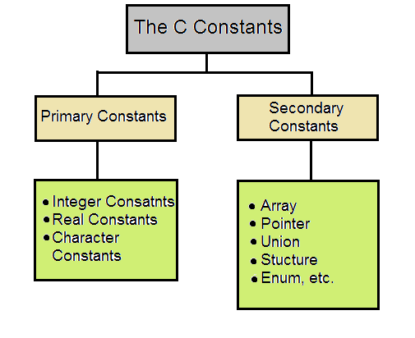
Constants

Slide 49
Constants
Primary constants
Primary constants represent basic data values.
They include:
Integer Constants: whole numbers (e.g., 10, -5)
Real (Floating) Constants: decimal numbers (e.g., 3.14, 0.5)
Character Constants: single characters (e.g., 'A', '9')

Slide 50
Constants
Secondary constants
Secondary constants are derived (formed from primary constants) and are used to store multiple values or complex data.
They are not single values like integers or characters.
They include:
Array: Stores multiple values of the same data type under one name(int a[5] = {1, 2, 3, 4, 5};)
Pointer: Stores the address of another variable(int x = 10; int *p = &x;)
Structure: Groups variables of different data types(
struct student {
int id;
char name[20];
};)

